Slide 1
PERSONALITY PREDICTION
FROM MYERS-BRIGGS
PERSONALITY TYPE DATASET

Slide 2
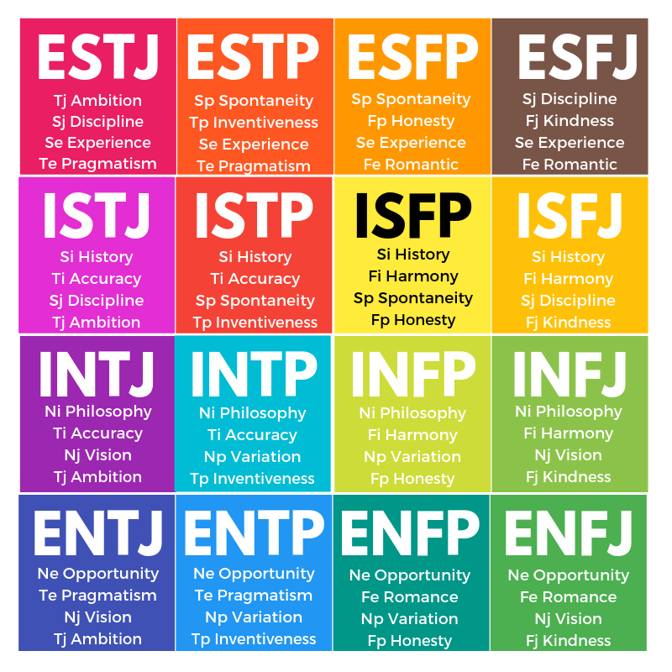
PROBLEM STATEMENT
Predicting the Personality of a person on the basis of his/her writing style from the 16 Myers Briggs personality types.
16 Personality Types
There are 16 personality types on the Myers-Briggs Type Indicator instrument, which is called a "type table".
As an example, someone labelled as INTP in the MBTI system prefers introversion, intuition, thinking and perceiving personality.

Slide 3
MYERS-BRIGGS PERSONALITY TYPES….
E
EXTROVERTS
Are energized by people, enjoy a variety of tasks, a quick pace and are good at multitasking.
S
SENSORS
Are realistic people who like to focus on the facts and details, and apply common sense and past experience to come up with practical solutions to problems.
I
INTROVERTS
Often like working alone or in small groups, prefer a more deliberate pace, and like to focus on one task at a time.
N
INTUITIVES
Prefer to focus on possibilities and big picture, easily see patterns, value innovation, and seek creative solutions to problems.
T
THINKERS
Tend to make decisions using logical analysis, objectively weigh pros and cons, and value honesty, consistency and fairness.
J
JUDJERS
Tend to be organised and prepared, like to make and stick to plans, and are comfortable following most rules.
F
FEELERS
Tend to be sensitive and cooperative, and decide based on their own personal values and how others will be affected by their actions.
P
PERCEIVERS
Prefer to keep their options open, like to be able to act spontaneously, and like to be flexible with masking plans.

Slide 4
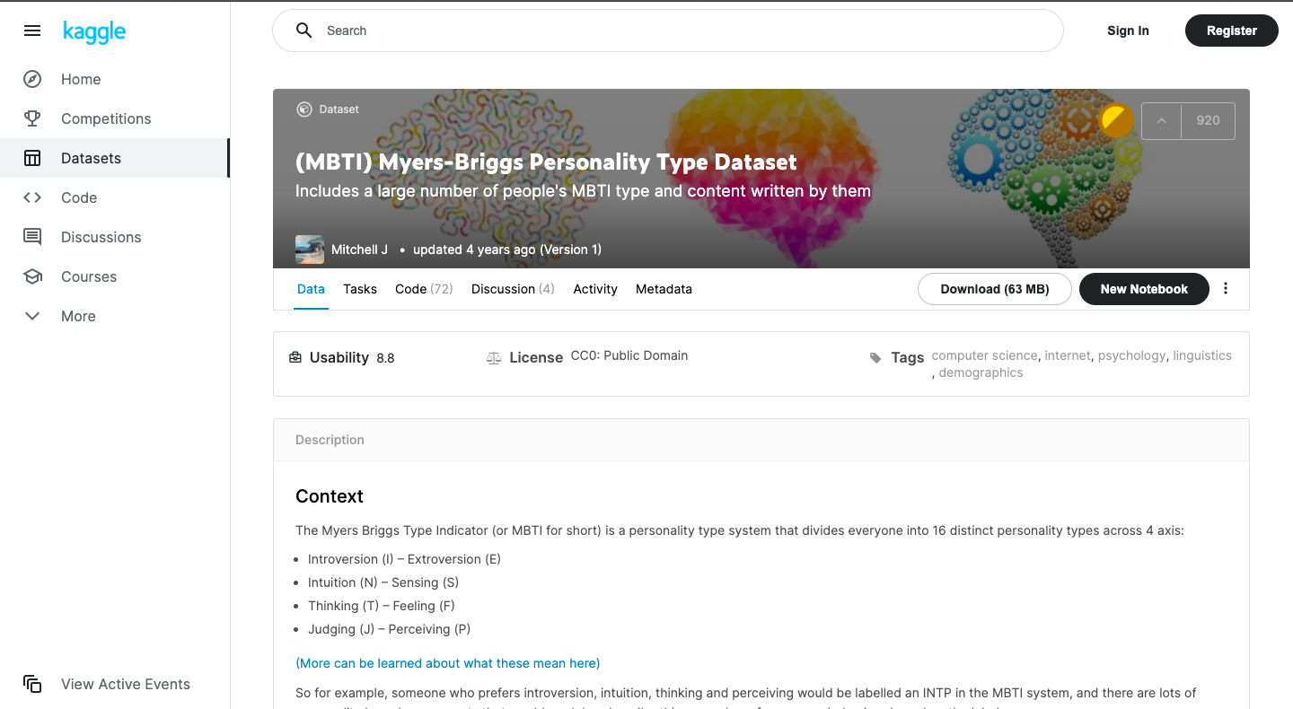
DATASET
The main dataset is publicly available on “kaggle.com” containing 8675 rows of data. It has only 2 columns:
1. Myers Briggs Type Indicator (MBTI) personality Type for a person (e.g ESFP, INTJ etc)
2. Last 50 Posts by the person on social media, separated by "|||". This data has been collected from the users through a forum from personalityCafe.com .
https://www.kaggle.com/datasnaek/mbti-type

Slide 5
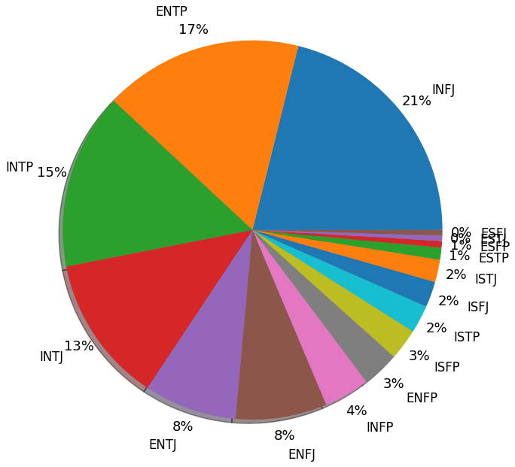
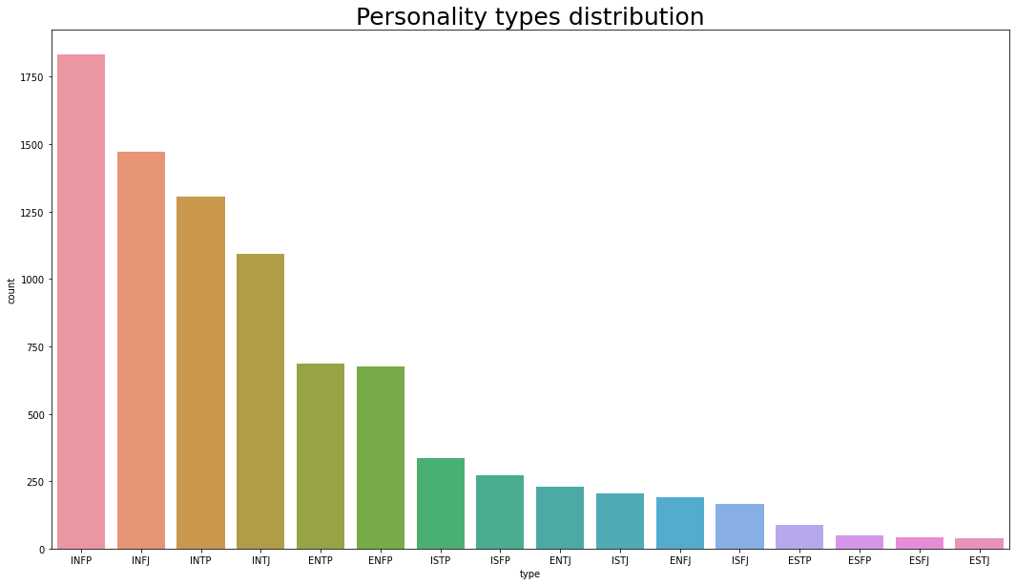
Exploratory Data Analysis (EDA)
As can be seen from the above pie plot that there exists variation in the dataset among personality types as INFJ among the highest covering 21% of the whole dataset.

Slide 6
Preprocessing
Train-Test Split
Splitted the dataset into 70-30 % ratio with stratify for handling class imbalancement
1. Removing URLs
2. Removing End Tokens like '?', ',' '.'
3. Remove words that contain digits
4. Lower casing words
5. Removing multiple letters repeating words
6. Removing Parentheses
Feature Extraction
Implemented Bag of Words, TF-IDF and selected maximum features = 5000 for countvectorizer and TFIDF
7. Removing more than 1 spacing
8. Removal of Stop Words
9. Lemmatization

Slide 7
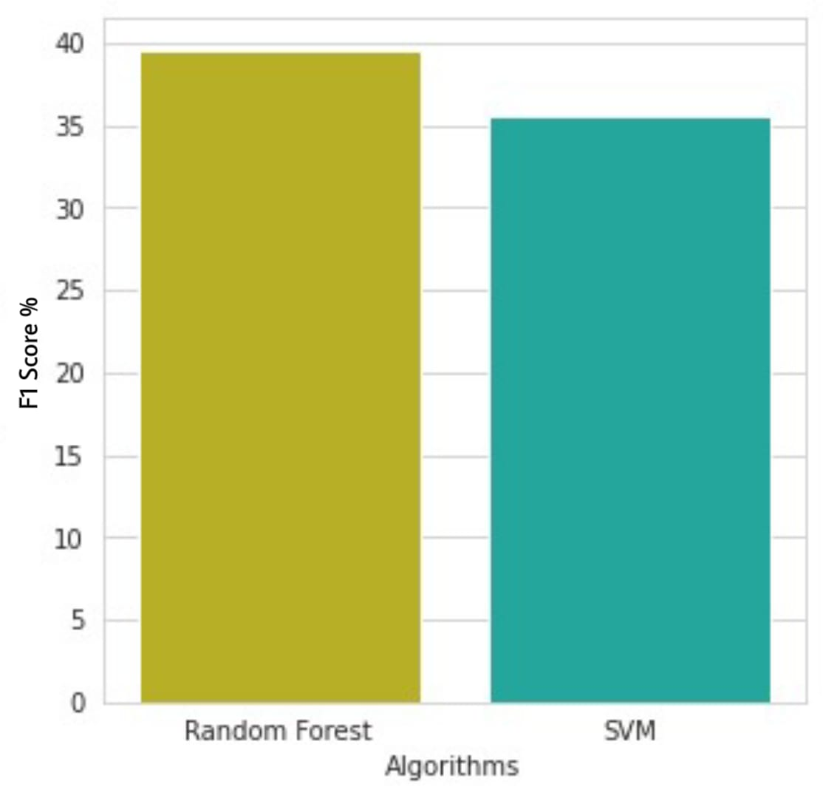
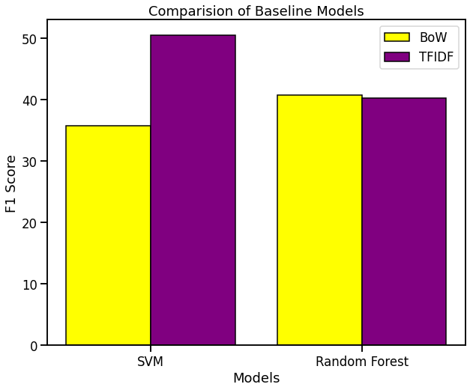
BASELINE SYSTEMS
BEFORE
AFTER
We have chosen Random forest and Support Vector Machine (SVM) as our baseline models.
As per our analysis, we have observed that Random forest outperforms SVM in terms of accuracy for our dataset.
We have compared above Baseline models i.e SVM and Random Forest by capturing their F1-Scores using Bag of Words Techniques and TF-IDF Techniques represented by yellow and purple color respectively. As can be seen there is a huge improvement in case of SVM while comparable scores for random forest.

Slide 8
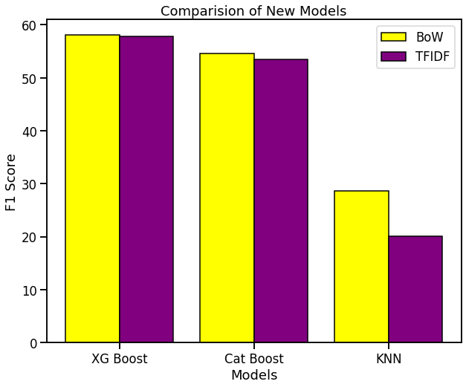
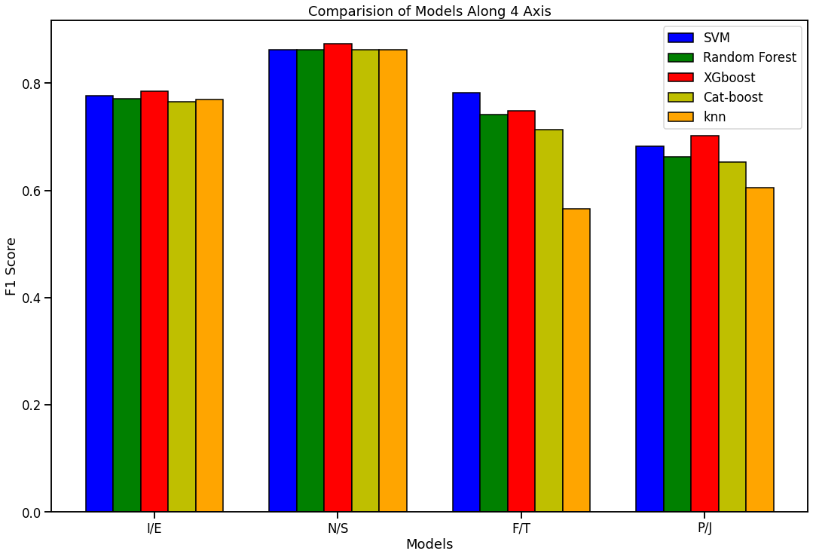
FINAL MODELS, RESULTS AND CONCLUSIONS
We have implemented New Boosting techniques XG-Boost, CatBoost and KNN classification using both Bag of Words Technique and TF-IDF but observed that TF-IDF even performed less precisely as compared to BoW techniques. So, There is a need arises for some new formulation either to dataset or models to increase the f1 scores since earlier approaches did not appear acceptable.
As we have seen all the ML models that we have applied have given F1 score of around 0.5 which is pretty bad.
So instead of training model on all 16 types of personalities, we now try to train models on 4 classifiers individually for better predictions.
16 Personality types across 4 axis :
Introversion (I) – Extroversion (E)
Intuition (N) – Sensing (S)
Thinking (T) – Feeling (F)
Judging (J) – Perceiving (P)
As we can see from the graph, XGBoost is out-performing all other models along all the MBTI axis except F/T. For F/T, SVM has performed slightly better than XGboost.But overall XGboost has performed the best in comparison to the other models. So we are considering XGBoost as our final model.

Slide 9
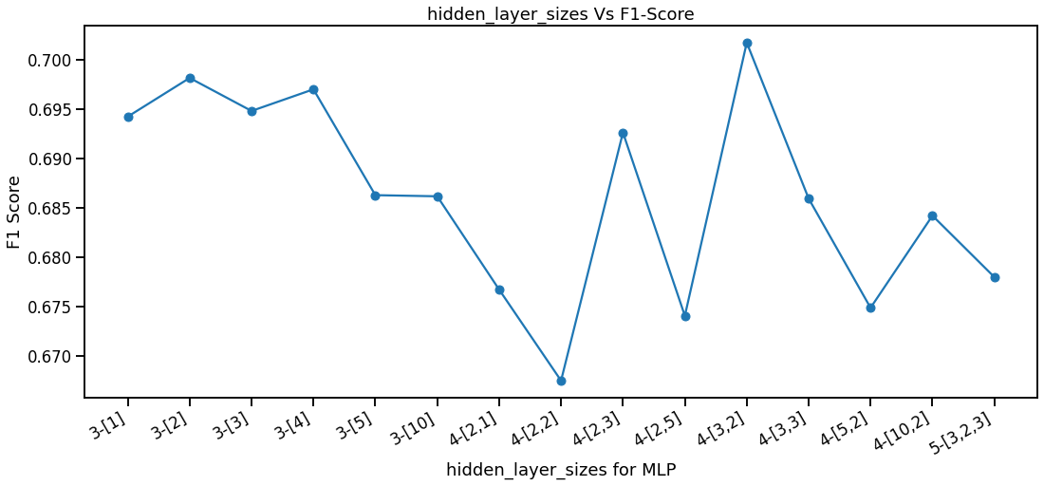
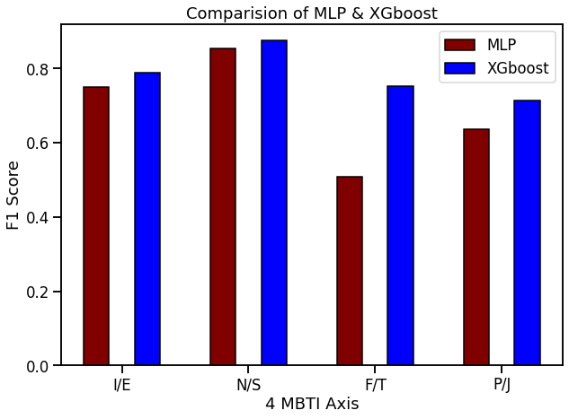
FINAL MODELS, RESULTS AND CONCLUSIONS
Also applying MLP (Deep Learning)
As we can see MLP has performed the best when total number of layers = 4 including 2 hidden layers with nodes = 3,2 respectively. So we will be considering this in our further analysis and evaluation.
We can see that XGboost has also outperformed MLP.
So we are considering XGBoost as our final model.
We have tried to predict one of our group member‘s (Jatin Agarwal) personality to verify our results. We passed around ten statements written by him to our model. His actual personality type is INFJ, and our model has predicted his personality type as INFP.
Actual Personality Type: INFJ
Predicted Personality Type: INFP

Slide 10
TEAM PERSONALITY AND CONTRIBUTIONS
Yukti Goswami M.Tech CSE MT21109
Creation, analysis, editing and designing of content as well as presentation and reports
Aman Srivastava M.Tech CSE MT21007
Implementation of baseline while managing and keeping everything in-place and up-to-date.
The project is a collective effort of each member in the team. We worked together and monitored every component equally and simultaneously.
Jatin Agarwal M.Tech CSE MT21032
Studied various models and gathered information through numerous research papers and prepared reports.

Slide 11
THANKS!

